Slide 1

Course No: IPE 6107
Course Title : Machine learning I
Holistic Framework for Bangla Sentiment Analysis: Accuracy, Efficiency, and Sustainability
                Submitted To
                Dr. Ridwan Al Aziz
                Assistant Professor,
                Bangladesh University of Engineering and Technology (BUET)
  Submitted By
  Team No – 15
  0424082030 – Mostafizur Rahman Khan(Team Leader)
  0424082027 – Nayan Nath
  0423082006 – Sourav Paul
  0423082116 – Sanjida Hassan

Slide 2
Presentation Outline
Introduction
Motivation for the study
Literature Review
Research Gap
Research Objective
Research Question
Proposed Methodology
Data Collection
Future work
Expected Outcome
Conclusion
References

Slide 3
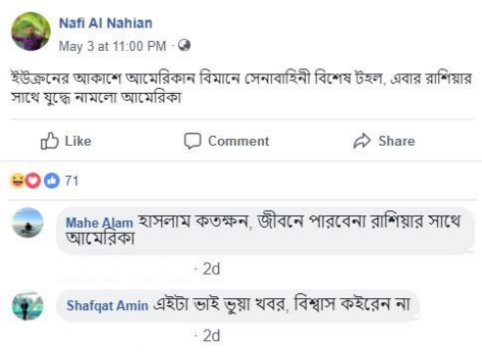
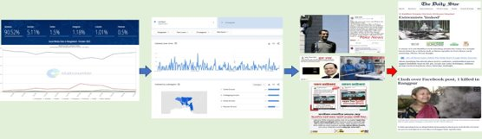
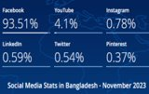
Introduction
In the digital landscape of Bangladesh, where over 93% of internet users engage on Facebook, the spread of unverified information has become a prevalent concern.
Understanding individual sentiments toward these rumors is crucial to analyzing rumor propagation dynamics, necessitating nuanced categorization into positive, negative, or neutral reactions. Here, ‘sentiment’ refers to whether a comment on a rumor post expresses positive, negative, or neutral emotion.

Slide 4
Motivation
Social media in Bangladesh is a primary channel for spreading information, but also for misinformation and rumors.
Understanding sentiment (positive, negative, neutral) is key to analyzing rumor propagation and public opinion.
Existing sentiment analysis methods mainly focus on accuracy-based evaluation, ignoring practical deployment costs such as latency, energy use, and carbon emissions.
Recent advances in LLMs and Bangla-specific encoders provide opportunities to improve both performance and real-world usability.

Slide 5
Literature Review

Slide 6
Table 1: Data collection information, features, and tools used in recent studies
No. | Article | Data collection platform | Data collection way | Study population | Considerable Features | Applied Tools
1 | Xing (2025) | News and social media platforms | Six FSA datasets (FPB, StockSen, CMC, FiQA, SEntFiN and FinEntity) | 32835 datapoints | Financial news, social media posts and forum discussions | Heterogeneous LLM agents framework, summative agent reasoning
2 | Katta (2025) | Reddit | AsyncPRAW (Asynchronous Python Reddit API Wrapper) library | 10733 entries | Reddit comments | Sentiment analysis, LDA (Latent Dirichlet Allocation), word frequency approach, topic modeling
3 | Invernici et al. (2025) | Academic literature | Scopus database | Hundreds of thousands of documents (scientific abstracts, 2006-2023) | Abstracts and their metadata | BERTopic, LLM-based embeddings, hyperparameter optimizer, TETYS dashboard
4 | Wahidur et al. (2024) | Social media platforms | Neo dataset, Bitcoin sentiment dataset, Reddit dataset and Cryptocurrency sentiment dataset | 14091 tweets | Sentiment, tweet, posts | Microsoft's MiniLM (distilled BERT), Google's FLAN-T5, instruction-based fine-tuning
5 | Uddin & Sarker (2024) | Real-world phishing email dataset | Sourced from Kaggle website. | 11,322 legitimate Emails and 7,328 phishing Emails | Email content, class imbalance, positive and negative contribution scores | RoBERTa (fine-tuned), LITA (LIME-Transformer Attribution), LIME, Transformers Interpret

Slide 7
(Cont’d…)
No. | Article | Data collection platform | Data collection way | Study population | Considerable Features | Applied Tools
6 | Xu et al.(2024) | MIMIC-CXR dataset | Not mentioned | 500 radiology reports | Semantic similarity, text labels, clinical ground truth alignment | GPT-4, zero-shot learning framework
7 | Ghatora et al. (2024) | Customer product reviews | Sourced from Kaggle website. | 205,052 records | Product name, product price, rate, review, summary and sentiment (positive, negative and neutral). | Random Forest, Naive Bayes, SVM, GPT-4
8 | Thakur et al. (2024) | YouTube (with cross-platform analysis on Facebook and Twitter) | YouTube video descriptions analysis | 8122 videos | Four distinct themes: Promotion/Outreach, Treatment, Conspiracy Theories, Politics; sentiment distribution, language diversity, sharing patterns | Topic modeling, topic-specific sentiment analysis, language detection, correlation analysis
9 | Miah et al. (2024) | Not specified | SemEval-2017 Task 4: Sentiment Analysis in Twitter, amazon_reviews_multi, DEFT 2017, and SENTIPOLC 2016 | 8375 datapoints | Sentiment polarity (positive, negative, neutral), cross-lingual analysis | LibreTranslate, Google Translate, Twitter-Roberta-Base-Sentiment-Latest, bert-base-multilingual-uncased-sentiment, GPT-3
10 | Rehan et al. (2023) | Twitter and YouTube | Not mentioned | Urdu 2400 tweets and english 1313 posts | Tweets and comments | MuRIL, RoBERTa, transfer learning, fine-tuning, manual search and grid search for hyper-parameters

Slide 8
Table 2: Areas, objectives, results, and limitations of recent studies
No. | Article | Area of application | Objective of the study | Results | Limitations
1 | Xing (2025) | Miscellaneous | Investigate the effectiveness of using LLMs without fine-tuning for financial sentiment analysis through heterogeneous LLM agents framework | Better accuracies compared to alternative multi-LLM agent settings, especially when discussion contents are substantial. | Since LLM-based prediction is slower and costlier than statistical analysis, this makes large multi-agent systems less practical.
2 | Katta (2025) | Socialization | Analyze Reddit discussions about ChatGPT and DeepSeek using sentiment and topic modeling to understand user attitudes and public perception of LLMs | Identified significant topics including trust in AI, user expectations, potential uses, reservations about AI biases, and ethical implications. Provides insights into public sentiment shaping AI development direction. | The analysis is restricted to Reddit discussions.
3 | Invernici et al. (2025) | Teaching and Learning | Propose a completely automated pipeline to uncover discussions on SDGs within research literature using topic modeling techniques | Successfully identified hundreds of topics on hundreds of thousands of documents. Captured insights on evolution of attitude toward SDGs in scientific abstracts (2006-2023). Produced interactive visualizations of topics' temporal evolution. | Topic modeling in a high-dimensional latent space may yield overlapping topics.
4 | Wahidur et al. (2024) | Miscellaneous | To improve sentiment analysis for cryptocurrency market prediction by testing fine-tuning methods on DistilBERT, MiniLM, and FLAN-T5, focusing on instruction type, model size, and data scale. | 40% average zero-shot performance gain after fine-tuning. Larger models achieved 75.16% accuracy. Short instructions: 72.38% accuracy (12% better than complex instructions). | Smaller-scale models may experience reduced generalization due to complete model capacity utilization.

Slide 9
(Cont’d…)
No. | Article | Area of application | Objective of the study | Results | Limitations
5 | Uddin & Sarker (2024) | Miscellaneous | Present a fine-tuned transformer-based language model (RoBERTa) for detecting phishing emails and propose a hybrid explanation approach for model transparency | Fine-tuned model achieves high accuracy in phishing email classification. LITA provides user-friendly insights and solves disagreement issues between LIME and Transformers Interpret approaches. | Lack of multilingual and phishing email datasets.
6 | Xu et al.(2024) | Health Care | Leverage LLM to enhance semantic analysis and develop similarity metrics for texts, addressing limitations of traditional unsupervised NLP metrics | GPT-4 generated labels significantly improve semantic similarity assessment with scores more closely aligned with clinical ground truth than traditional NLP metrics (ROUGE, BLEU). | Framework tested only on radiology reports; generalizability to other specialized domains needs validation.
7 | Ghatora et al. (2024) | Miscellaneous | Explore the application of traditional machine learning and pre-trained LLMs for automated sentiment analysis of customer product reviews | Traditional models (especially SVM) better for short texts. GPT-4 showed superior performance with detailed texts, capturing subtle sentiments with higher precision, recall, and F1 scores. GPT-4 uniquely identified mixed sentiments not found in simpler models. | This research relied on a public dataset, which may not reflect the nuances of private organizational data.

Slide 10
(Cont’d…)
No. | Article | Area of application | Objective of the study | Results | Limitations
8 | Thakur et al. (2024) | Socialization | Analyze misinformation about COVID-19 on YouTube through topic modeling, sentiment analysis, language analysis, and cross-platform sharing patterns | 4 themes identified. Sentiment analysis: Promotion (45.8% neutral, 39.8% positive); Treatment (38.1% positive, 31.3% neutral); Conspiracy (46.9% positive, 31.0% neutral); Politics (35.7% positive, 32.9% negative). English videos shared most on Facebook/Twitter. Significant correlation between video title length and social media shares. | May not capture the full scope of misinformation dynamics across other social media platforms such as Facebook or TikTok.
9 | Miah et al. (2024) | Miscellaneous | Propose an ensemble model of transformers and LLM for sentiment analysis of foreign languages by translating them into English | Over 86% accuracy in sentiment analysis on translated sentences. Ensemble model outperformed independent pre-trained models and LLM individually | Challenging when dealing with foreign languages without labelled training data.
10 | Rehan et al. (2023) | Socialization | Address Multi-lingual Threatening Content Detection (MTCD) using transfer learning with fine-tuning techniques | RoBERTa achieved highest performance: 92% accuracy and 90% macro F1-score with joint multi-lingual approach. | Very limited work in low-resource languages.

Slide 11
Research Gap
Lack of systematic evaluation of Bangla sentiment analysis frameworks that combine topic modeling + encoders and LLM-based approaches.
Prior studies largely overlook resource efficiency and sustainability metrics (e.g., inference time, energy consumption, carbon footprint).
Limited exploration of how translation models (M2M100) and multilingual LLMs can support Bangla text processing.
Few works integrate robust optimization into the evaluation of sentiment models to capture uncertainty in operational costs.

Slide 12
Research Question
How can traditional topic modeling (LDA, BERT-LDA, BERTopic) and LLM-based topic modeling be effectively combined with encoders (BanglaBERT, XLM-RoBERTa) for Bangla sentiment analysis?
What is the relative performance trade-off between topic modeling + encoder pipelines and direct LLM prompting?
How can we design a cost-aware evaluation framework that jointly considers accuracy, latency, energy consumption, and carbon emissions?
Under uncertainty (e.g., fluctuating costs, variable energy prices), which models remain robust in sentiment analysis tasks?

Slide 13
Research Objective
Develop a comparative framework for Bangla sentiment analysis using:
  Classical topic modeling + encoders.
  LLM-based topic modeling + encoders.
  Direct LLM prompting.
Integrate robust optimization techniques into model evaluation to account for operational and sustainability costs.
Analyze trade-offs between interpretability, modularity, scalability, and efficiency across different model families.
Provide a benchmark for Bangla-specific sentiment analysis that goes beyond accuracy to include time, energy, and environmental costs.

Slide 14
Methodology

Slide 15
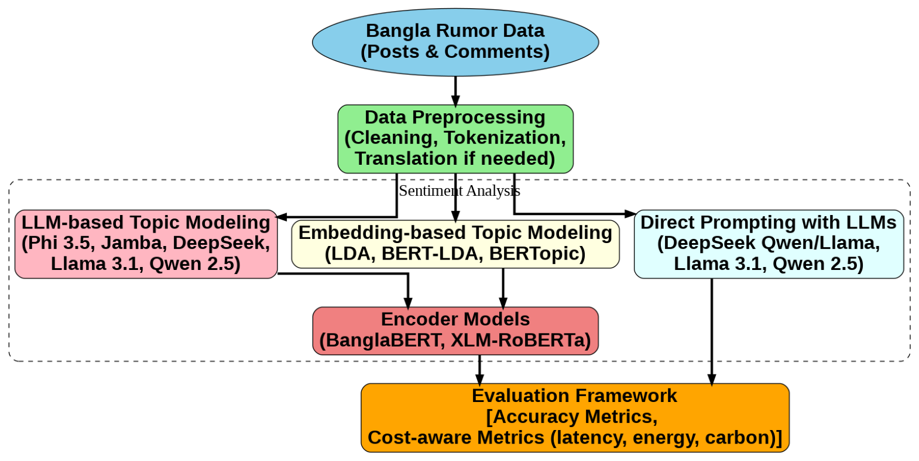
Block Diagram of proposed framework

Slide 16
Data Collection

Slide 17
Data Collection Method
1
Facebook Rumor post links are collected manually from the "Rumor Scanner" website.
Semi-automatic
2
Data (such as posts, comments, etc.) about Facebook Rumor Post links are extracted using a web scraper.

Slide 18
Sample Data
Post Title | Comments | Stance
ইন্দোনেশিয়া কোরআনের হাফেজ কে মাটি দেয়ার সময় কবর আলোকিত হয়ে যায়। সুবহানাল্লাহ্ (In Indonesia, the grave of a Hafiz of the Quran lit up during the burial. SubhanAllah.) | সুবহানাল্লাহ (SubhanAllah.) | Positive
 | মিথ্যা কথা (False statement.) | Negative
 | দয়া করে আমার পোস্ট টা আপনাদের গ্রুপে ছারেন (Please share my post in your group.) | Neutral

Slide 19
TOPIC MODELING

Slide 20
Table 3: Embedding-Based and LLM-Based Topic Modeling Approaches
Embedding-based topic modeling | LDA
 | BERT-LDA
 | BERTopic
LLMs for prompting-based topic modeling | Phi 3.5 Mini / MoE
 | Jamba Mini 1.5
 | DeepSeek distillations (DS Qwen 14B / 32B, DS Llama 8B / 70B)
 | Llama 3.1 8B / 70B
 | Qwen 2.5 7B / 72B

Slide 21
Table 4: Comparison of Topic Modeling Approaches: Fundamentals, Advantages, and Limitations
Model | Fundamentals & Assumptions | Advantages | Limitations
LDA (Latent Dirichlet Allocation) | Generative probabilistic model. Each document = mixture of latent topics; each topic = distribution over words. Assumes bag-of-words independence (word order ignored). | Unsupervised and language-agnostic – requires no annotated data, making it suitable for low-resource languages like Bangla. Interpretable topic-word distributions. Stronger generalization than pLSI/LSA via Dirichlet priors. | Ignores semantics, context, and word order. Requires predefined number of topics. Performs poorly on short texts.
BERT-LDA (BERT + LDA Hybrid) | Uses contextual embeddings (BERT) to improve semantic coherence. Assumes embeddings capture meaning better than raw co-occurrence. | Addresses LDA’s limitation: lack of semantics. Produces more coherent topics (groups synonyms/related phrases). Better performance on short texts. | Resource-intensive (embedding + clustering). Still needs bag-of-words for topic labeling.

Slide 22
(Cont’d…)
Model | Fundamentals & Assumptions | Advantages | Limitations
BERTopic (Embedding-based Topic Model) | Clusters transformer embeddings of documents. Uses class-based TF–IDF (c-TF-IDF) for topic labels. | Addresses BERT-LDA’s complexity: integrates clustering + labeling in one pipeline. High topic coherence. Modular (any embedding model can be plugged in). Handles dynamic topics over time. | Assigns one dominant topic per document. Still bag-of-words for topic labels → misses phrase-level nuance. Heavy computation for huge datasets.
Phi 3.5 (Mini & MoE) | Small language models (SLMs) with transformer backbone. Mini: efficient, 3.8B params, 128k context. MoE: 16 experts, ~42B total, ~6.6B active per inference. | Addresses BERTopic’s limitation: non-generative, limited reasoning. Strong reasoning/coding ability despite small size. MoE balances performance vs efficiency. | Bangla is not explicitly listed; for Bangla, it might occasionally produce awkward phrasing or rely on more general knowledge. Smaller models still lack deep world knowledge. MoE adds deployment complexity.

Slide 23
(Cont’d…)
Model | Fundamentals & Assumptions | Advantages | Limitations
Jamba 1.5 Mini (AI21Labs) | Hybrid architecture: Transformer + State-Space Model (SSM). Supports 256k context (longest among peers). | Addresses Phi-3.5’s limitation: limited context. State-of-the-art long document analysis. Faster decoding efficiency for long inputs. | Bangla was not explicitly listed as a supported language. Complex architecture (MoE + SSM). Very high hardware requirements for large models.
DeepSeek Distillations (DS Qwen-14B/32B & DS Llama-8B/70B) | Knowledge distilled from a huge 671B MoE teacher into smaller Qwen/Llama bases. Focus on reasoning and chain-of-thought. | Efficient reasoning in multiple languages (like Bangla). Addresses Jamba’s limitation: weaker reasoning compared to distilled teacher knowledge. Superior reasoning at smaller scale. Performs step-by-step problem solving well. | Bias and flaws from the teacher model can transfer. Still large (8B–70B), not lightweight.

Slide 24
(Cont’d…)
Model | Fundamentals & Assumptions | Advantages | Limitations
Llama 3.1 (8B / 70B) | Meta’s dense LLM is trained on 15T tokens. Instruction-tuned with 10M curated examples. 128k context. | High general intelligence and strong multilingual abilities (for its supported languages) Addresses DeepSeek’s limitation: narrow focus on reasoning. Balanced general-purpose model. Strong ecosystem + fine-tuning support. | Resource-heavy (esp. 70B). Slightly behind Qwen in multilingual/code benchmarks.
Qwen 2.5 (7B / 72B) | Trained on 18T tokens (largest among peers). Strong multilingual + coding specialization. 32k context. | State-of-the-art multilingual performance and multimodality: Qwen-2.5-72B is one of the most capable open models as of 2025. Addresses Llama 3.1’s limitation: not top in multilingual/code tasks. State-of-the-art open-source performance. Excels at reasoning, coding, and multilingual tasks. | 72B model requires heavy computing. Proprietary MoE versions only via API.

Slide 25
sENTIMENT Classification

Slide 26
Table 5: Encoder-Based and LLM-Based Models for Sentiment Classification
Encoder models | BanglaBERT
 | XLM-RoBERTa
LLMs for prompting-based sentiment analysis | DeepSeek distillations (DS Qwen 14B / 32B, DS Llama 8B / 70B)
 | Llama 3.1 8B / 70B
 | Qwen 2.5 7B / 72B

Slide 27
Table 6: Comparison of Sentiment Classification Approaches: Fundamentals, Advantages, and Limitations
Model | Fundamentals & Assumptions | Advantages | Limitations
BanglaBERT | Monolingual BERT-base encoder trained only on Bangla text. Uses masked language modeling. Assumes Bangla-only training captures better syntax and semantics than multilingual. | Directly overcomes the limitation of generic multilingual models that lacked Bangla depth. Strong grasp of Bangla vocabulary and grammar. Higher accuracy on Bangla sentiment tasks. Lightweight (~110M params) and easy to fine-tune. | Poor at handling Banglish (Bangla + English mix). Struggles with transliterated Bangla. Limited to 512 tokens. No generative or reasoning ability.
XLM-RoBERTa | Multilingual RoBERTa encoder trained on 100 languages (including Bangla). Uses shared subword vocabulary for cross-lingual transfer. Assumes high-resource languages can boost low-resource languages. | Overcomes BanglaBERT’s limitation of poor handling of code-mixing and transliteration. Covers Bangla plus related languages, improving mixed text handling. | Bangla is underrepresented in its training → misses idioms/slang. Still context-limited (~512 tokens). Not tuned specifically for Bangla sentiment out of the box.

Slide 28
(Cont’d…)
Model | Fundamentals & Assumptions | Advantages | Limitations
DeepSeek Distillations (DS Qwen-14B/32B & DS Llama-8B/70B) | Distilled models using Qwen or Llama backbones. Knowledge distilled from reasoning-heavy training. Assumes reasoning skill transfers to multiple languages. | Overcomes XLM-R’s limitation of limited capacity and short context. Longer context windows → handles full Bangla threads or articles. Strong reasoning → can detect sarcasm or irony in Bangla sentiment. Efficient open-source models easier to adapt than massive dense LMs. | Not natively trained on Bangla → needs extra fine-tuning. Larger models still require significant compute. Misses some idiomatic Bangla cues unless adapted.
Llama 3.1 (8B / 70B) | Next-gen Transformer (8B–405B params). Trained on large multilingual corpora, with 128K context. Assumes massive scale + instruction tuning = superior multilingual performance. | Overcomes DeepSeek’s limitation of limited Bangla exposure. Trained on broader language data → stronger Bangla fluency. Detects subtle sentiment shifts and sarcasm in Bangla. Can analyze entire long documents or conversations. | Very large (70B+ params) → costly to run. Bangla still less represented than English/Chinese. Improvements in sentiment classification may be marginal over smaller tuned models.

Slide 29
(Cont’d…)
Model | Fundamentals & Assumptions | Advantages | Limitations
Qwen 2.5 (7B / 72B) | Alibaba’s efficient LLM family (up to 72B params). Long context (128K), optimized training to rival larger models. Assumes efficiency + smart training can outperform larger dense models. | Overcomes Llama 3.1’s limitation of impractical scale and deployment. Nearly state-of-the-art Bangla understanding at smaller size. Long context helps with lengthy sentiment-rich Bangla texts. Easier to fine-tune and deploy than 70B–405B Llama models. | Training still focused mainly on Chinese/English → Bangla needs fine-tuning. Subword tokenization may fragment Bangla words. 72B model still resource-demanding for small labs.

Slide 30
Combination for Sentiment Analysis

Slide 31
Table 7: Combinations for Sentiment Analysis
No. | Combination for Sentiment Analysis
 | Topic Modeling | Sentiment Classification
1 | LDA | BanglaBERT
2 | LDA | XLM-RoBERTa
3 | BERT-LDA | BanglaBERT
4 | BERT-LDA | XLM-RoBERTa
5 | BERTopic | BanglaBERT
6 | BERTopic | XLM-RoBERTa
7 | Phi 3.5 Mini | BanglaBERT
8 | Phi 3.5 Mini | XLM-RoBERTa

Slide 32
(Cont’d…)
No. | Combination for Sentiment Analysis
 | Topic Modeling | Sentiment Classification
9 | Phi 3.5 MoE | BanglaBERT
10 | Phi 3.5 MoE | XLM-RoBERTa
11 | Jamba Mini 1.5 | BanglaBERT
12 | Jamba Mini 1.5 | XLM-RoBERTa
13 | DeepSeek DS Qwen 14B | BanglaBERT
14 | DeepSeek DS Qwen 14B | XLM-RoBERTa
15 | DeepSeek DS Qwen 32B | BanglaBERT
16 | DeepSeek DS Qwen 32B | XLM-RoBERTa

Slide 33
(Cont’d…)
No. | Combination for Sentiment Analysis
 | Topic Modeling | Sentiment Classification
17 | DeepSeek DS Llama 8B | BanglaBERT
18 | DeepSeek DS Llama 8B | XLM-RoBERTa
19 | DeepSeek DS Llama 70B | BanglaBERT
20 | DeepSeek DS Llama 70B | XLM-RoBERTa
21 | Llama 3.1 8B | BanglaBERT
22 | Llama 3.1 8B | XLM-RoBERTa
23 | Llama 3.1 70B | BanglaBERT
24 | Llama 3.1 70B | XLM-RoBERTa

Slide 34
(Cont’d…)
No. | Combination for Sentiment Analysis
 | Topic Modeling | Sentiment Classification
25 | Qwen 2.5 7B | BanglaBERT
26 | Qwen 2.5 7B | XLM-RoBERTa
27 | Qwen 2.5 72B | BanglaBERT
28 | Qwen 2.5 72B | XLM-RoBERTa
29 | - | DeepSeek DS Qwen 14B
30 | - | DeepSeek DS Qwen 32B
31 | - | DeepSeek DS Llama 8B
32 | - | DeepSeek DS Llama 70B

Slide 35
(Cont’d…)
No. | Combination for Sentiment Analysis
 | Topic Modeling | Sentiment Classification
33 | - | Llama 3.1 8B
34 | - | Llama 3.1 70B
35 | - | Qwen 2.5 7B
36 | - | Qwen 2.5 72B

Slide 36
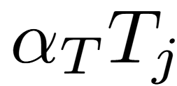
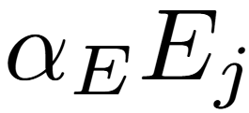
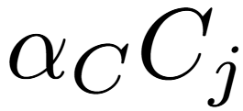
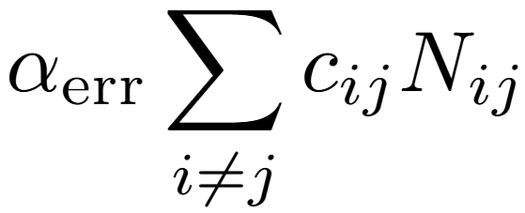
Metrics
Usual metrics: Accuracy, Precision, Recall, F1, Confusion Matrix.
Limitation: Ignore time, energy, carbon, and cost of misclassification.
Our approach: Robust optimization framework combining
Latency ( ) (Strubell et al., 2020)
Energy ( ) (Strubell et al., 2020)
Carbon footprint ( ) (Lannelongue et al., 2021)
Cost-sensitive errors ( ​) (Elkan, 2001)
Ensures model choice is robust under uncertainty (e.g., fluctuating costs, carbon pricing).
Provides a holistic evaluation: accuracy + efficiency + sustainability + impact.

Slide 37
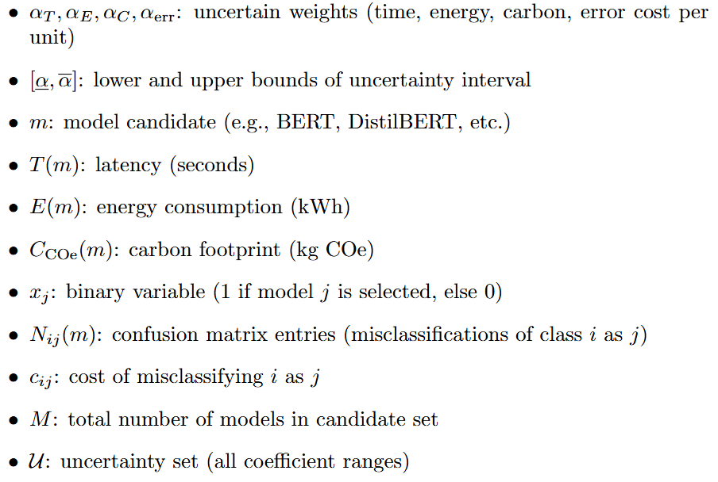
Notations

Slide 38
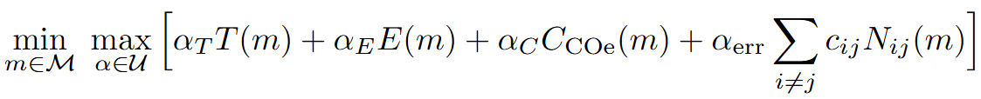
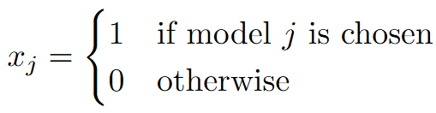
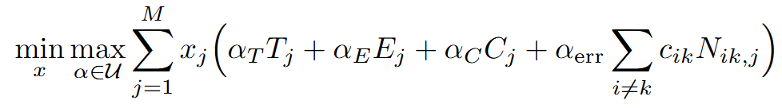
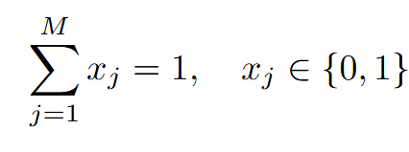
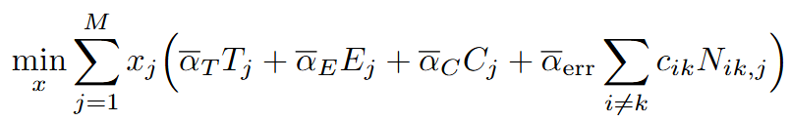
Robust Optimization Formulation
Step 1: Interval Definitions
Suppose each weight has uncertainty:
Step 2: Robust (min–max) Formulation
Step 3: MILP Formulation (if discrete models)
Introduce binary decision variables:
Then:
subject to:
Step 4: Linearization (Robust Counterpart)
For intervals, the worst-case objective simplifies:
So the robust counterpart is:

Slide 39
Expected Outcome
Benchmark of 36 model configurations for Bangla sentiment prediction.
LLM-based topic modeling + encoders → richer embeddings, higher accuracy.
Direct LLM prompting → competitive accuracy but higher cost (latency, energy).
BanglaBERT outperforms XLM-RoBERTa in Bangla-only tasks.
Novel cost-aware evaluation framework (accuracy + time + energy + carbon).
Practical deployment guidelines balancing accuracy and efficiency.
Framework generalizable to other low-resource languages.

Slide 40
Conclusion
Demonstrated that LLM-based topic modeling provides richer embeddings, improving downstream sentiment classification compared to classical topic modeling.
BanglaBERT and XLM-RoBERTa perform strongly when paired with LDA/BERT-LDA/BERTopic, ensuring high accuracy with moderate cost.
Direct LLM prompting achieves competitive performance but at significantly higher latency and energy costs.
The robust cost-aware evaluation framework highlights that the “best” model depends not only on accuracy but also on deployment constraints (e.g., real-time vs. batch processing).

Slide 41
Future Works
Extend evaluation to stance detection (support, deny, query, comment) alongside sentiment (positive, negative, neutral).
Explore knowledge distillation or parameter-efficient tuning (LoRA, adapters) to reduce LLM inference cost for Bangla text.
Incorporate graph-based or multi-modal features (e.g., network propagation, images, videos) for richer rumor analysis.
Test the framework on real-world Bangla social media datasets with evolving rumor events.
Develop an open-source benchmark toolkit for cost-aware sentiment prediction in low-resource languages.

Slide 42
References

Slide 43
Xing, F. (2025). Designing heterogeneous llm agents for financial sentiment analysis. ACM Transactions on Management Information Systems, 16(1), 1-24.
Katta, K. (2025). Analyzing User Perceptions of Large Language Models (LLMs) on Reddit: Sentiment and Topic Modeling of ChatGPT and DeepSeek Discussions. arXiv preprint arXiv:2502.18513.
Invernici, F., Curati, F., Jakimov, J., Samavi, A., & Bernasconi, A. (2025). Capturing research literature attitude towards sustainable development goals: an LLM-based topic modeling approach. Journal of Big Data, 12(1), 139.
Wahidur, R. S., Tashdeed, I., Kaur, M., & Lee, H. N. (2024). Enhancing zero-shot crypto sentiment with fine-tuned language model and prompt engineering. IEEE Access, 12, 10146-10159.
Uddin, M. A., & Sarker, I. H. (2024). An explainable transformer-based model for phishing email detection: A large language model approach. arXiv preprint arXiv:2402.13871.
Xu, S., Wu, Z., Zhao, H., Shu, P., Liu, Z., Liao, W., ... & Li, X. (2024). Reasoning before comparison: LLM-enhanced semantic similarity metrics for domain specialized text analysis. arXiv preprint arXiv:2402.11398.
Ghatora, P. S., Hosseini, S. E., Pervez, S., Iqbal, M. J., & Shaukat, N. (2024). Sentiment analysis of product reviews using machine learning and pre-trained llm. Big Data and Cognitive Computing, 8(12), 199.

Slide 44
Thakur, N., Cui, S., Knieling, V., Khanna, K., & Shao, M. (2024). Investigation of the misinformation about covid-19 on youtube using topic modeling, sentiment analysis, and language analysis. Computation, 12(2), 28.
Miah, M. S. U., Kabir, M. M., Sarwar, T. B., Safran, M., Alfarhood, S., & Mridha, M. F. (2024). A multimodal approach to cross-lingual sentiment analysis with ensemble of transformer and LLM. Scientific Reports, 14 (1), 9603.
Rehan, M., Malik, M. S. I., & Jamjoom, M. M. (2023). Fine-tuning transformer models using transfer learning for multilingual threatening text identification. IEEE Access, 11, 106503-106515.
Strubell, E., Ganesh, A., & McCallum, A. (2020, April). Energy and policy considerations for modern deep learning research. In Proceedings of the AAAI conference on artificial intelligence (Vol. 34, No. 09, pp. 13693-13696).
Lannelongue, L., Grealey, J., & Inouye, M. (2021). Green algorithms: quantifying the carbon footprint of computation. Advanced science, 8(12), 2100707.
Elkan, C. (2001, August). The foundations of cost-sensitive learning. In International joint conference on artificial intelligence (Vol. 17, No. 1, pp. 973-978). Lawrence Erlbaum Associates Ltd.

Slide 45
Thank You
Please let me know if you have any question

